Slide 1
Azure Data Factory
DEVOPS

Slide 2
Overview
Azure Data Factory (ADF) is a cloud-based ETL and data integration service that allows you to create data-driven workflows for orchestrating data movement and transforming data at scale.
Azure Data Factory is composed of below key components.
Pipelines
Activities
Datasets
Linked services
Data Flows
Integration Runtimes
Azure IR
Self Hosted IR
SSIS IR

Slide 3
Need for Azure Data Factory
Azure Cloud native data orchestration service
ADF can copy data from on-prem, Azure and 3rd party cloud supporting 90+ data sources
Very easy to use Low-code development environment
Integrated metrics and monitoring
Tracks data lineage
Easy to integrate various data services

Slide 4
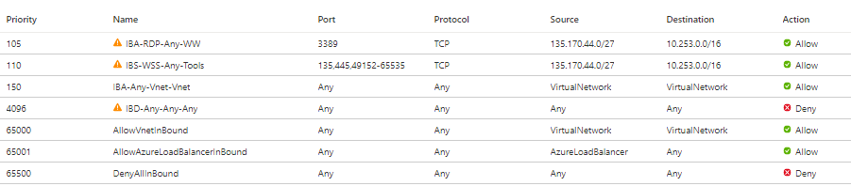
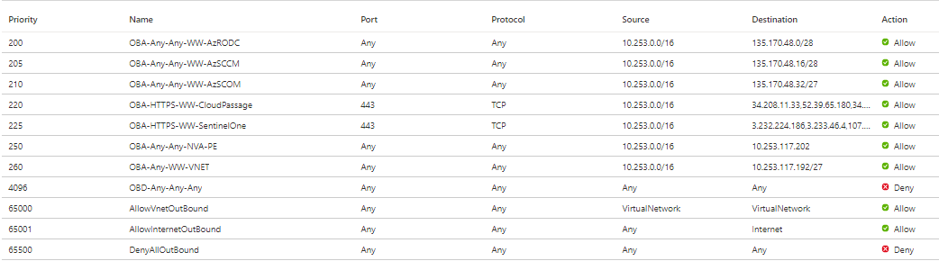
Registration of Self-Hosted IR on Azure – NSG settings
Inbound rules
Outbound rules
(*) Added inbound connectivity from the Virtual Network since 4096 rule blocks all inbound and RDP requires to connect to through Bastion Private Endpoint and WW PLS (**) Added outbound connectivity to WW Virtual Network since 4096 rule blocks all outbound and SHIR requires to connect to Data Factory through Private Endpoint

Slide 5
Role Bases Access Control (RBAC) Built-in roles
Built-in role | Description
Contributor | Lets you manage everything except granting access to resources.
Data Factory Contributor | Create and manage data factories, as well as child resources within them
Owner | Lets you manage everything, including access to resources.
Reader | Lets you view everything, but not make any changes.
User Access Administrator | Lets you manage user access to Azure resources.
Roles and permissions for Azure Data Factory - Azure Data Factory | Microsoft Docs
Azure resource provider operations | Microsoft Docs
https://www.keepsecure.ca/blog/azure-data-factory-custom-roles/

Slide 6
Role Bases Access Control (RBAC) - Personas Custom roles
Custom role | Description
Operator | An ADF operator is someone who manages the health of an ADF instance. They could, for example, monitor job runs, queue lengths, etc. They would never make changes to the ADF itself in terms of data pipeline code
Developer | An ADF developer is someone who would have access to make changes to developer relates components such as pipelines, activities, and data sets. They wouldn’t create or modify linked services, and they wouldn’t schedule triggers or other runs.
Admin | This is your infrastructure administrator who is responsible for the ADF itself. Typically, they would have full access to the ADF. Most importantly, they would be the ones creating/modifying security settings, repository settings, and linked services.
Data | This role might make sense for a subset of developers who are responsible for creating/maintaining datasets and the various configurations in that dataset. You could create a data role separate from your developer role.

Slide 7
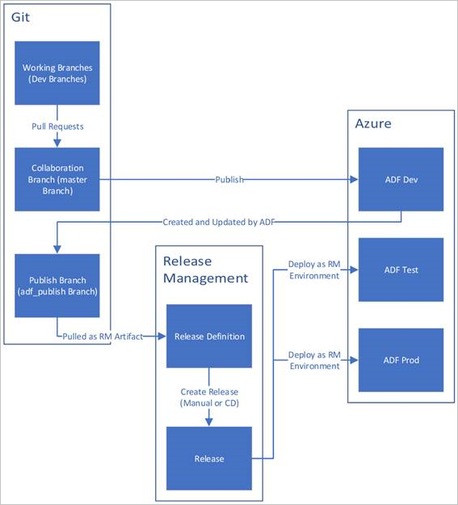
DevOps Process
1
1
A development data factory is created and configured with Azure Repos Git. All developers should have permission to author Data Factory resources like pipelines and datasets. A developer creates a feature branch to make a change. They debug their pipeline runs with their most recent changes. For more information on how to debug a pipeline run, see Iterative development and debugging with Azure Data Factory.
After a developer is satisfied with their changes, they create a pull request from their feature branch to the master or collaboration branch to get their changes reviewed by peers.
After a pull request is approved and changes are merged in the master branch, the changes get published to the development factory.
When the team is ready to deploy the changes to a test or UAT (User Acceptance Testing) factory, the team goes to their Azure Pipelines release and deploys the desired version of the development factory to UAT. This deployment takes place as part of an Azure Pipelines task and uses Resource Manager template parameters to apply the appropriate configuration.
After the changes have been verified in the test factory, deploy to the production factory by using the next task of the pipelines release.
2
3
2
4
4
4
3
4
5
5
Reference: Continuous integration and delivery in Azure Data Factory - Azure Data Factory | Microsoft Docs

Slide 8
Azure Data Factory instance for multiple projects: POC
Conclusion.
1. A proof of concept that a single ADF instance can accommodate multiple projects securely with incorporated DevOps and has the ability to be released to selected target environment on different cadence/timing.
A Single Azure Repos Git organization can have multiple repositories, but an Azure Repos Git repository can be associated with only one data factory.
Single ADF can configure multiple pipeline pipelines, data sets, triggers, linked services, Private Endpoints, and integration runtimes.
https://docs.microsoft.com/en-us/azure/data-factory/source-control
2. Recommendation
Recommendation will be target environment on different data factory to leverage the performance, low latencies and less complicity. Please refer the slide 10 to target environment deployment using ADF.
3. Can ADF be shared among projects without impacting each other.
Recommendation will be according to Microsoft Single Azure project can have multiple Repo however advisable is to connect each repo to each ADF implementation.
4. Can ADF be connected to multiple Azure git repo? If not, can a code be organized by folder and be deployed by folder?
Recommendation will be a single Repository can be associated with only one Azure Data Factory
3.Can we release project features in different cadence to different target environment?
Please reference slide 10

Slide 9
URL
Source control in Azure Data Factory: https://docs.microsoft.com/en-us/azure/data-factory/source-control
Continuous integration and delivery in Azure Data Factory: https://docs.microsoft.com/en-us/azure/data-factory/continuous-integration-delivery
Install Azure Data Factory Integration Runtime: https://docs.microsoft.com/en-us/azure/data-factory/create-self-hosted-integration-runtime
Azure Data Factory Limitation: https://github.com/MicrosoftDocs/azure-docs/blob/master/includes/azure-data-factory-limits.md
ADF Pricing plan : https://azure.microsoft.com/en-us/pricing/details/data-factory/data-pipeline/

Slide 10


